Slide 1
Army OPORD Brief
Student’s Name
Institution

Slide 2
Introduction
Operation order (OPORD) refers to a directive that a leader gives to his junior leaders to ensure that there is a coordinated performance of a given order.
Army OPORD brief utilizes a five-paragraph format to ensure that the junior leaders understand the order and execute it in completeness.
A leader issues his OPORD briefing orally using notes that follow the five-paragraph format.

Slide 3
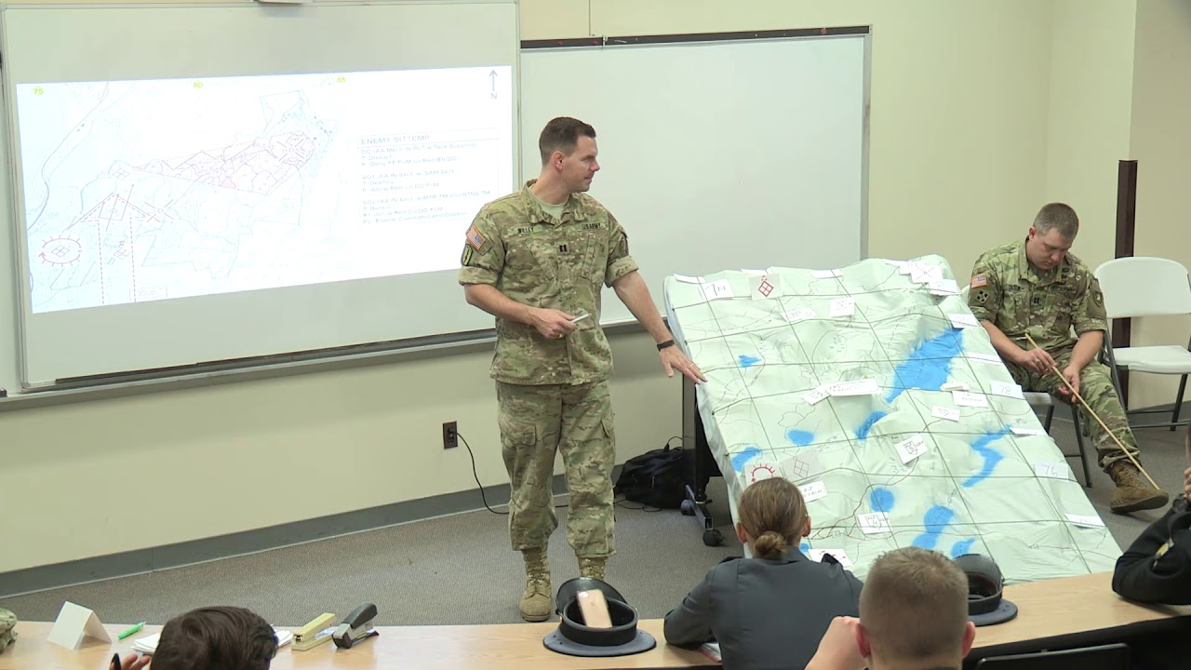
Paragraph 1: The Situation
This paragraph involves information of detailed status of both enemy and friendly forces. It contains:
Enemy Forces. Information about the enemy. Enemy Forces also include pertinent data:
Weather and light
Terrain (OAKOK)
Enemy Capabilities
Enemy Composition
Enemy Intentions

Slide 4

Paragraph 1: The Situation
Enenemy Forces:
Terrain- Terrain defines the area of operations well as area of interest, advantages disadvantages t both friendly and enemy forces. They are abbreviated AOKOC:
Avenues of approach
Observation and field of fire
Key terrain
Obstacles
Cover and Concealment

Slide 5
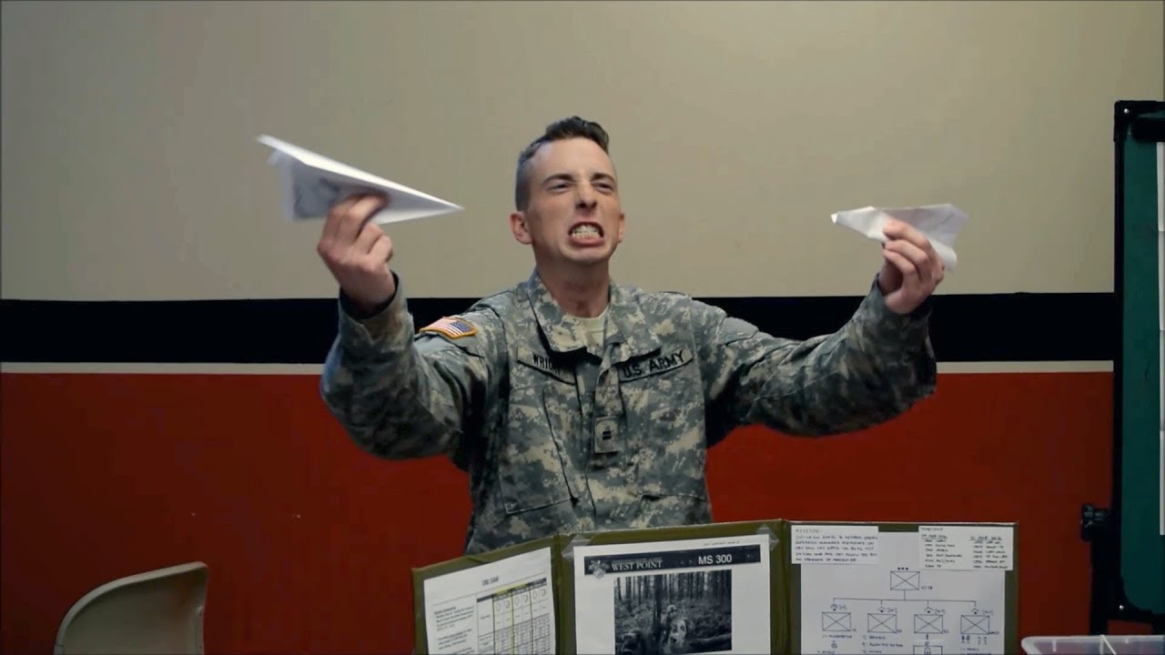
Paragraph 1: The Situation
Enemy Forces
Weather and light Data- defines the advantages and disadvantages of weather to friendly and enemy forces as well as the impact to the mission. They include;
Precipitation
Temperature
Wind, dust, fog
Light Data include BMNT, Sunrise, Sunset, Moonrise, and Moonset

Slide 6
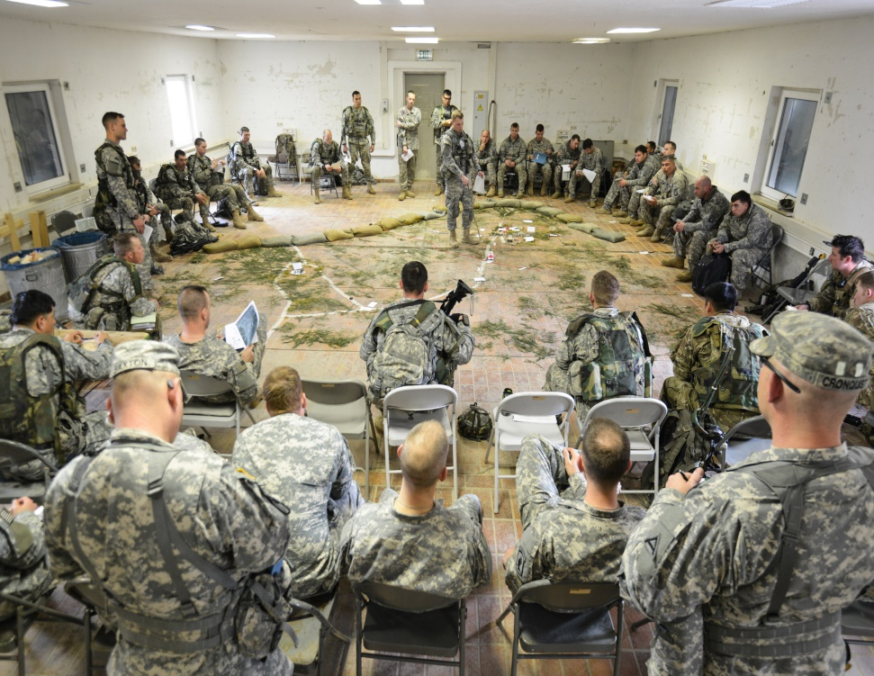
Paragraph 1: The Situation
Enemy Forces
Enemy composition, strengths , Disposition- Defines the characteristics of the enemy as described in SALUTE, as well as the advantages and disadvantages to friendly and enemy forces and their impact on the mission.
S- Size
A- Ativities
L- Last seen location
U- Their Unit designation
T- Last time seen
E- Equipment they have

Slide 7
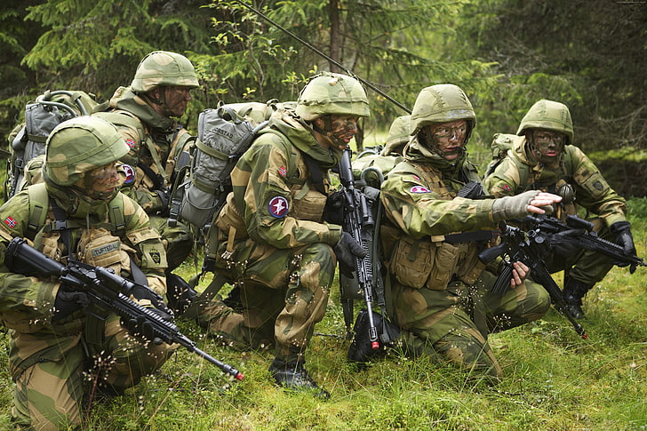
Paragraph 1: The Situation
Enemy Forces
Enemy Capability- This basically describes the enemy combating capability. It includes:
Range and orientation of direct and indirect fires
Reserves
Counter-attack forces
Repositioning ability
Mobility and counter-mobility

Slide 8
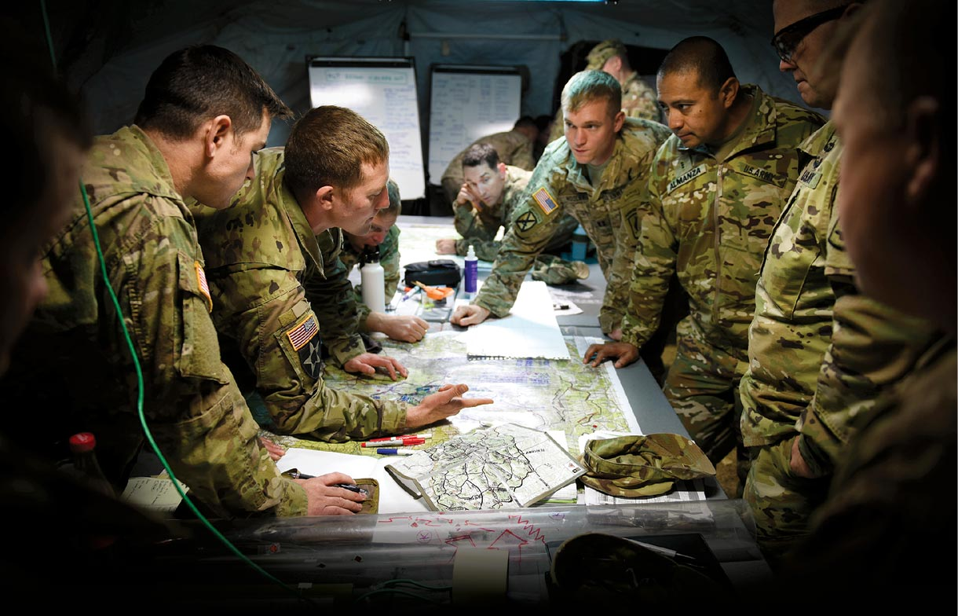
Paragraph 1: The Situation
Enemy Forces
Enemy Intentions- they include:
The most possible and dangerous enemy’s curse of action
How the enemy is likely to attack, or defend
Critical enemy events

Slide 9
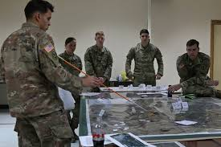
Paragraph 1: Situation
Friendly Forces. Information about missions as well as locations. They include adjacent unit missions, higher unit missions, and supporting unit missions.
Attachments and detachments. This contains information about non-organic units attached or organic units detached from the unit. It must give the unit and effective time of attachment or detachment. It states “none” where there are no attachments and detachments.

Slide 10
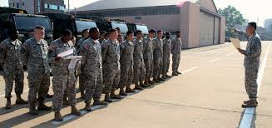
Paragraph 2: Mission
It contains a statement of what a given unit is assigned to execute. It must be clear and concise.
Gives the primary task of the unit and its objectives in five-Ws; Who (unit) What (assignment) Where (location) Why( purpose) When (time).

Slide 11
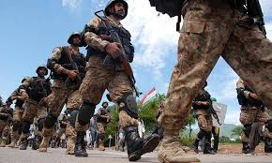
Paragraph 3: Execution
This paragraph contains the information on how the task/operation will be performed.
It contains four sub-paragraphs: Commander’s intent, Operation concept, Tasks and Coordinating Instructions.

Slide 12
Paragraph 3: Execution
Commander’s Intent: Ties together the concept of operation and the mission statement
Concept of operation: Contains scheme of Maneuver and Fire Support Plan
Scheme of maneuver: Overview of how junior units will execute the plan. It uses anonymous terms and does not mention specific units.
Fire Support Plan: It explains how the fire support will come in in helping the complementation of the scheme of maneuver.
Tasks : Explains the specific missions that each subordinate unit must complete. The units must answer the five Ws of their missions in their mission statements.
Coordinating Instructions: These are specific instructions that tie together the missions. They include time of attack, the main effort/base unit and order of movement, security, route to the objective and tactical control measures.

Slide 13

Paragraph 4: Administration and logistics
The paragraph covers all the information that the units can use for their resupply, equipment recovery and evacuating the prisoners and the injured. It is represented by 4Bs: Bullets(ammunition), Beans (chow) Badguys (EPWs) and Band-aids (MEDEVAC)
Administration: medical evacuation procedure for the injured and enemy prisoners of war (EPWs)
Logistics: Preliminary issue and resupply procedures, transportation etc.

Slide 14
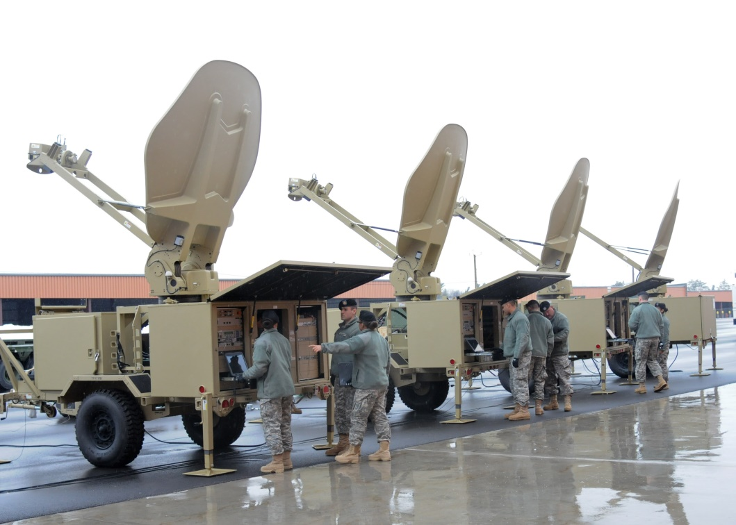
Paragraph 5: Command and Signal
This is the last paragraph which contains information and instructions on command and control functions.
Command: Identifies one’s location, the location of the leaders and junior leaders as required.
Signal: Identifies signal instructions to be used in the operation. Signal instructions include:
Prearranged signals
Radio call signs and radio procedures
Restricted use of communication
Emergency signals
Countersigns and passwords
Pyrotechnics

